Slide 1
IoT Agent for the ElfinCR interface

Slide 2
OCB
IoT Agent
North (NGSI port)
Southport
C#
ElfinCR
V5
Elfin

Slide 3
OCB
IoT Agent
NGSI
{Id, Type, “DataSheet”:{...}, “Actual_TCP_Pos”
Data Preparation
Cmd
DataSheet
“DataSheet”:{...}
tcp/ip server
tcp/ip client
“DataSheet”:{...}
ElfinCR
V5
Elfin

Slide 4
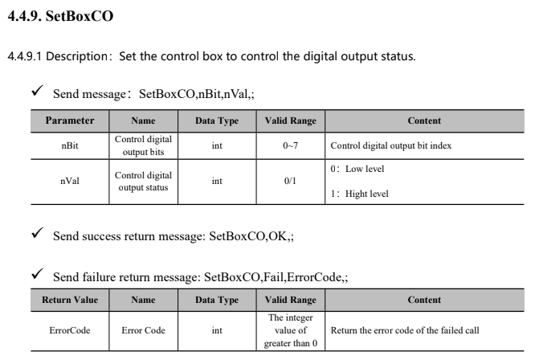
Set Operations (OCB → IoT Agent → Robot)
IoT Agent Framework → Commands
Id:R1
APP
Type: ElfinCR
t’
“elfinCmd”
“SetBoxCO,6,4,;”
“elfinCmd_info”
“SetBoxCO,OK,;”
“elfinCmd_status”
t’’ (t’ + Texec)
OCB - NGSI Entity
IOTA
Robot

Slide 5
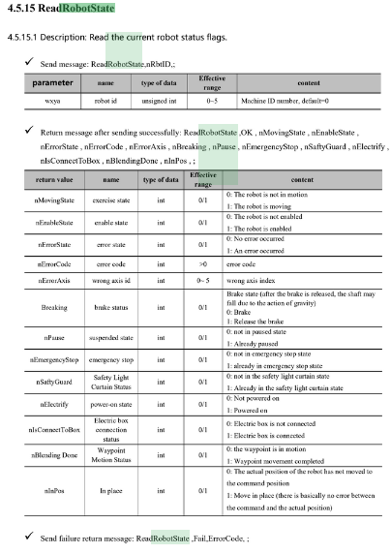
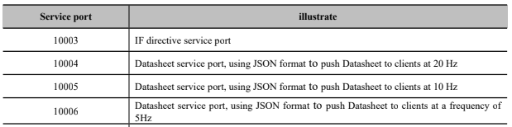
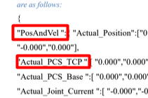
Read Operations (Robot → IoT Agent → OCB)
Robot State Datasheet is served using TCP/IP
Id:R1
Type: ElfinCR
“elfinCmd”*
“elfinCmd_info”
“elfinCmd_status”
“DataSheet”
“PosAndVel”
Message payload is a JSON object containing the robot state datasheet
“Actual_PCS_TCP”

Slide 6
Links
IoT Agent for JSON
Documentation
https://fiware-iotagent-json.readthedocs.io/en/latest/index.html
Section on “how to develop” new agents
https://fiware-iotagent-json.readthedocs.io/en/latest/usermanual.html#development-documentation
IoT Agent for JSON - FIWARE Tutorial
https://fiware-tutorials.readthedocs.io/en/latest/iot-agent-json.html
Custom IoT Agents - FIWARE Tutorial
https://github.com/FIWARE/tutorials.Custom-IoT-Agent

Slide 7
Action Points
Alberto envía a Francisco un escenario:
Objeto completo de Datasheet
Ejemplos de subestructuras que interesaría tener como atributo de primer nivel
Francisco trabajará en un ejemplo
Active Attrs
Lazy Attrs
Commands

